Slide 1

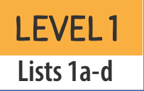
List 1a
a i
c h d m n w
ch ll th
Notes:
First word: mat

Slide 2
List 1b
a i
c h n m s t
ch th wh
Notes:
First word: this

Slide 3
List 1c
a i
d h m n p s
ll ch th
Notes:
First word: in

Slide 4
List 1d
a i
m n p t w
ll th wh
Notes:
First word: an

Slide 5
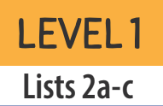
List 2a
a i
b m n p t
ch sh ss th
Notes:
First word: miss

Slide 6
List 2b
a i
c h m p t
ll th ss tt
Notes:
First word: at

Slide 7
List 2c
a i
f h d d m p s t
ch ll
Notes:
First word: fat

Slide 8
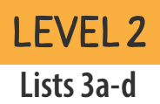
List 3a
a i o
b d g l p s
sh
Notes:
First word: gas

Slide 9
List 3b
a i o
b d f r s t w
ll
Notes:
First word: if

Slide 10
List 3c
a i
d f l m n r p x
sh
Notes:
First word: Max (a boy’s name)

Slide 11
List 3d
a i o
b d f g h m
p t x
Notes:
First word: hat

Slide 12
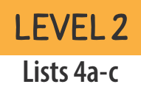
List 4a
i o
c d l m m p r t
ng sh
Notes:
First word: Tim

Slide 13
List 4b
e o
b g n p r t
ff ss
Notes:
First word: off

Slide 14
List 4c
a i
f g n r s w x
ch ng sh
Notes:
First word: rich

Slide 15
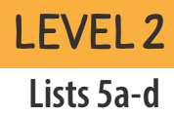
List 5a
a e i o
b f t w x
dd ll
Notes:
First word: add

Slide 16
List 5b
a e i o
b f g n r t
x ll
Notes:
First word: on

Slide 17
List 5c
a e o
c b d l s t
ll ng ss
Notes:
First word: bad

Slide 18
List 5d
a e o
d f g h l p r t
ng wr
Notes:
First word: fad (a craze)

Slide 19
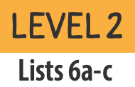
List 6a
a e i o
b l g r t w x
gu* ss
Notes:
First word: guess

Slide 20
List 6b
a e i o
b d g l s t
ll sh
Notes:
First word: beg

Slide 21
List 6c
a e i
b h g m n p r ng th wh
Notes:
First word: rag

Slide 22
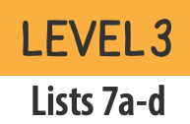
List 7a
o u
b d g j s t
ck th
Notes:
First word: jug

Slide 23
List 7b
a o u
b c f j n s t v ch
Notes:
First word: job

Slide 24
List 7c
i o u
g h j k m t
ck ss
Notes:
First word: kiss

Slide 25
List 7d
a o u
b h r s t
ck ng sh
Notes:
First word: tub

Slide 26
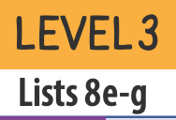
List 8a
a i u
g m n p r s
ch ck qu th
Notes:
First word: such

Slide 27
List 8b
a i u
b d d f g h k w ck sh
Notes:
First word: had

Slide 28
List 8c
a e u
g h j n p t v x
ff
Notes:
First word: vex (to annoy)

Slide 29
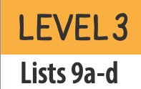
List 9a
a e i u
f k n r t
ng ss
Notes:
First word: fuss

Slide 30
List 9b
a e o u
b c j s t v
ck
Notes:
First word: us

Slide 31
List 9c
a e i u
b d j l m n s
ch ck
Notes:
First word: jam

Slide 32
List 9d
a i o u
b p p t
qu th ck
Notes:
First word: up

Slide 33
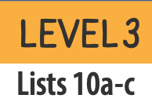
List 10a
a i o u
b c j k p p
ck ng sh
Notes:
First word: king

Slide 34
List 10b
e i o u
d g h k l m t
ch ck qu
Notes:
First word: deck

Slide 35
List 10c
e i o u
g h n m p s t
ck sh
Notes:
First word: sick

Slide 36
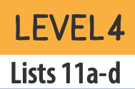
List 11a
a i o ar
d k p t z
ch sh
Notes:
First word: zip

Slide 37
List 11b
a e ar or
c b k m n p s
t y tch
Notes:
First word: yes

Slide 38
List 11c
a ar or
c f k m n t y
th
Notes:
First word: far

Slide 39
List 11d
a i or ar
c f n s t
ch th
Notes:
First word: nor (not)

Slide 40
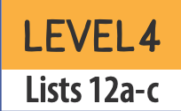
List 12a
a e i ar
h d n p y
ll sh tch
Notes:
First word: yard

Slide 41
List 12b
a i u ar
d h g k m w z
ch ng
Notes:
First word: much

Slide 42
List 12c
u ar or
h f m p t y
ck sh
Notes:
First word: or

